Slide 1


Ziwen Zhong
2023.05.06

Slide 2

Outline
Executive Summary
Introduction
Methodology
Results
Conclusion
Appendix

Slide 3
Executive Summary
Summary of methodologies:
Data collection
Data wrangling
Exploratory data analysis
Interactive visual analytics
Predictive analysis
Summary of all results
EDA with visualization results
EDA with SQL results
Interactive map with Folium results
Plotly Dash dashboard results
Predictive analysis (classification) results

Slide 4
Introduction
SpaceX advertises Falcon 9 rocket launches on its website with a cost of 62 million dollars; other providers cost upward of 165 million dollars each, much of the savings is because SpaceX can reuse the first stage.
We aim to determine if the first stage will land, and then we can determine the cost of a launch.
This information can be used if an alternate company wants to bid against SpaceX for a rocket launch.

Slide 5

Section 1

Slide 6
Methodology
Executive Summary
Data collection methodology:
Get a request to the SpaceX API
Web Scrapping
Perform data wrangling
Use the mean value for PayloadMass to impute the missing value
Perform exploratory data analysis (EDA) using visualization and SQL
Perform interactive visual analytics using Folium and Plotly Dash
Perform predictive analysis using classification models
Use sklearn to build, use GridSearchCV to tune, assess accuracy to evaluate classification models

Slide 7
Data Collection
Describe how data sets were collected.
You need to present your data collection process use key phrases and flowcharts

Slide 8
Data Collection – SpaceX API
The progress of data collection with SpaceX REST calls is presented as right using key phrases and flowcharts
The GitHub URL of the completed SpaceX API calls notebook with the completed code cell and outcome cell is: https://github.com/zzw-math/Winning-Space-Race/blob/main/jupyter-labs-spacex-data-collection-api.ipynb
Request data from SpaceX API
Decode response content as JSON
Turn it into a Pandas dataframe
Transform IDs to information using API
Construct the dataset
Filter dataframe to only include Falcon 9 launches
Reset the FlightNumber column
Impute missing value for PayloadMass with its mean

Slide 9
Data Collection - Scraping
The progress of the web scraping is presented as right using key phrases and flowcharts
The GitHub URL of the completed web scraping notebook is: https://github.com/zzw-math/Winning-Space-Race/blob/main/jupyter-labs-webscraping.ipynb
Request data from HTML
Create a BeautifulSoup from the response
Find all tables on the wiki page
Extract column name one by one
Fill in and parse the dictionary
Convert it to dataframe
Create an empty dictionary

Slide 10
Data Wrangling
We use value_counts in Pandas to calculate 3 things and convert outcome column to one-hot
The data wrangling process is presented as right using key phrases and flowcharts
The GitHub URL of completed data wrangling-related notebooks is: https://github.com/zzw-math/Winning-Space-Race/blob/main/labs-jupyter-spacex-data_wrangling_jupyterlite.jupyterlite.ipynb
Calculate the number of launches on each site
Calculate the number and occurrence of each orbit
Calculate the number and occurence of mission outcome per orbit type
Create a landing out come label from Outcome column

Slide 11
EDA with Data Visualization
Scatter plots were produced to visualise the relationship between flight number, payload and launch site, orbit type
A bar plot was induced to visualise the success rates for different orbit type
A line plot was conducted to show the success rate change by year
The GitHub URL of the completed EDA with data visualization notebook is https://github.com/zzw-math/Winning-Space-Race/blob/main/jupyter-labs-eda-dataviz.ipynb.jupyterlite.ipynb

Slide 12
EDA with SQL
Use distinct to get the name of the unique launch sites in the space mission
Use where and like to get 5 records whose launch sites begin with ‘CCA’
Use sum, where and like to obtain the total payload mass launched by NASA
Use avg, where and like to obtain the average payload mass carried by booster version F9 v1.1
Use min to get the date of the first successful landing outcome in the ground pad was achieved
Use where and like to obtain the names of the boosters which drone ship successfully and have payload mass between 4000 and 6000
Use count and group by to obtain the total number of successful and failed mission outcomes
Use subquery to obtain the names of booster_versions which have carried the maximum payload mass
Use substr, where, and like to obtain the records which fail to drone ship in 2015
Use count, where and group by to obtain the ranking of the count of successful landing between 2010-06-04 and 2017-03-20
The GitHub URL of the completed EDA with SQL notebook is https://github.com/zzw-math/Winning-Space-Race/blob/main/jupyter-labs-eda-sql-coursera_sqllite.ipynb

Slide 13
Build an Interactive Map with Folium
Mark all launch sites on a map using markers, green for success, red for failed
Use mark clusters (circle) to show many markers at the same location
Calculate the distances between a launch site to its proximities and add lines in the map to represented by them
The GitHub URL of the completed interactive map with Folium map is: https://github.com/zzw-math/Winning-Space-Race/blob/main/lab_jupyter_launch_site_location.jupyterlite.ipynb

Slide 14
Build a Dashboard with Plotly Dash
Use pie charts to show each launch site’s proportion of successful launches among total successful launches and the proportion of successful launches among all launches for each launch site.
Use the scatter plots to show the correlation between outcome and payload mass
The GitHub URL of the completed Plotly Dash lab is: https://github.com/zzw-math/Winning-Space-Race/blob/main/spacex_dash_app.py

Slide 15
Predictive Analysis (Classification)
The model development process is presented as right using key phrases and a flowchart
The GitHub URL of the completed predictive analysis lab is: https://github.com/zzw-math/Winning-Space-Race/blob/main/SpaceX_Machine_Learning_Prediction_Part_5.jupyterlite.ipynb
Use sklearn to build the models
Use GridSearch to tune the hyperparameters
Calculate accuracy rate for each model to evaluated them
Use bar chart to compare the accuracy rate for the four models.

Slide 16
Results
Exploratory data analysis results
Interactive analytics demo in screenshots
Predictive analysis results

Slide 17

Section 2

Slide 18
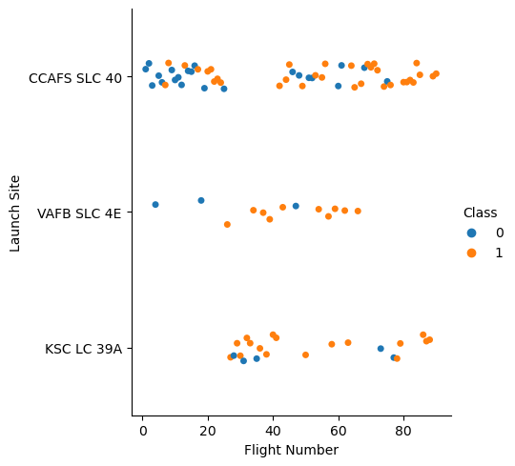
Flight Number vs. Launch Site
The scatter plot of Flight Number vs. Launch Site is as right
Flights with flight numbers less than 25 were mostly launched at CCAFS SLC 40
Flights with higher flight numbers have a higher successful launch rate
CCAFS SLC 40 has the lowest successful launch rate

Slide 19
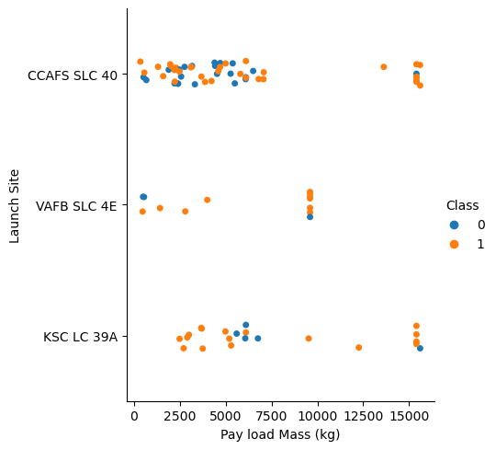
Payload vs. Launch Site
The scatter plot of Payload vs. Launch Site is as right
CCAFS SLC 40 has the lowest successful launch rate
Most flights’ payload masses are below 7500
Flights with payload mass higher than 7500 has a higher successful launch rate

Slide 20
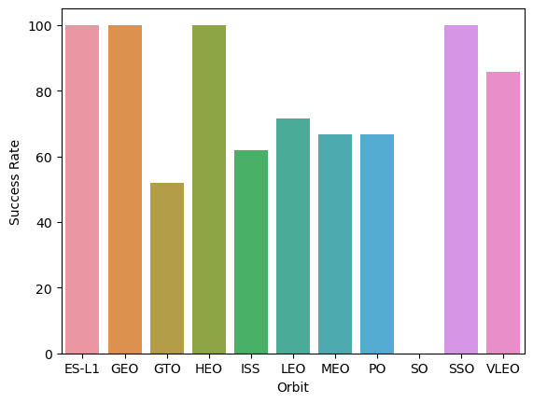
Success Rate vs. Orbit Type
The bar chart for the success rate of each orbit type is as right
ES-L1, EGO, HEO, SSO, VLEO has the highest success rate higher than 80%
The success rates for GTO, ISS, LEO, MEO, PO are around 50%
The success rate for SO is 0%

Slide 21
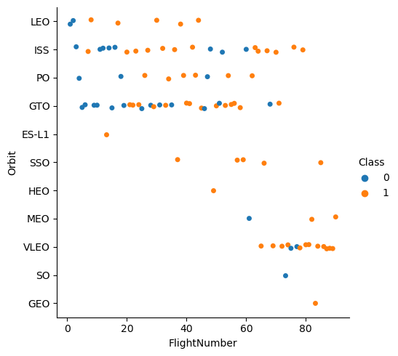
Flight Number vs. Orbit Type
The scatter point of Flight number vs. Orbit type is as right
The successful launch rate increase as flight number increase
ES-L1, HEO, SO, GEO only have one sample, so the success rate for them is not impressive

Slide 22
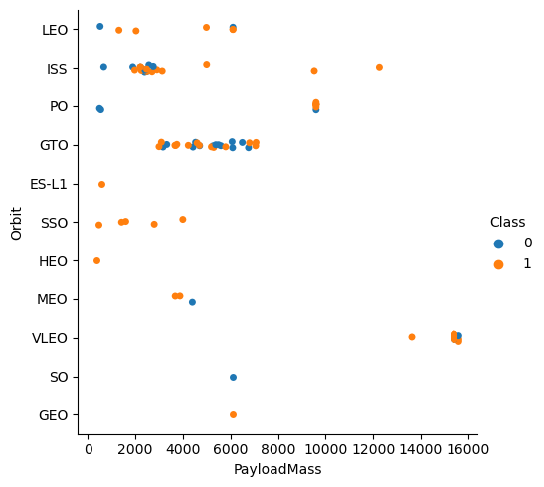
Payload vs. Orbit Type
The scatter point of payload vs. orbit type is as right
The payload mass of VLEO is mostly higher than 15000
For LEO, ISS, and PO flights with higher payload mass have a higher success rate

Slide 23
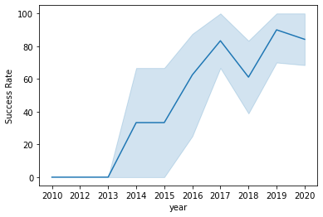
Launch Success Yearly Trend
The line chart of the yearly average success rate is as right
Before 2013, all launched failed
After 2013, the success rate increased, with small dips in 2018 and 2020

Slide 24
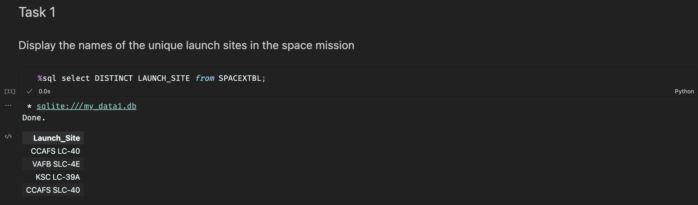
All Launch Site Names
Find the names of the unique launch sites
The word DISTINCT returns only unique values from the Launch_Site column of the SPACEXTBL table.

Slide 25
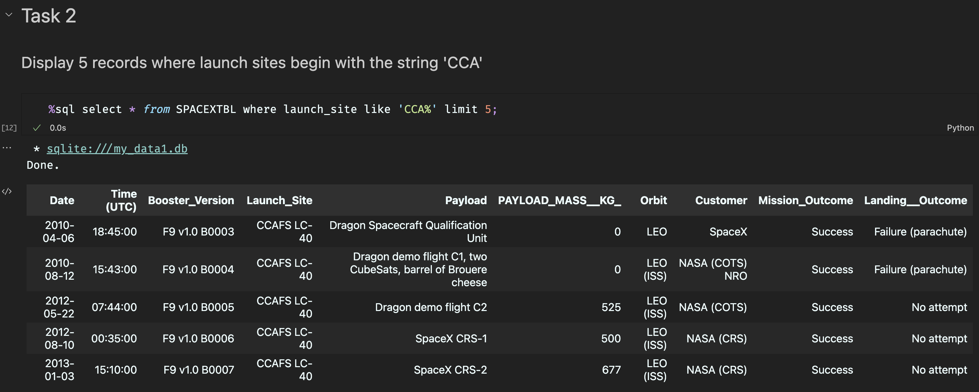
Launch Site Names Begin with 'CCA'
Find 5 records where launch sites begin with `CCA`
LIMIT 5 fetches only 5 records, and the LIKE keyword is used with the wild card ‘CCA%’ to retrieve string values beginning with ‘CCA’.

Slide 26
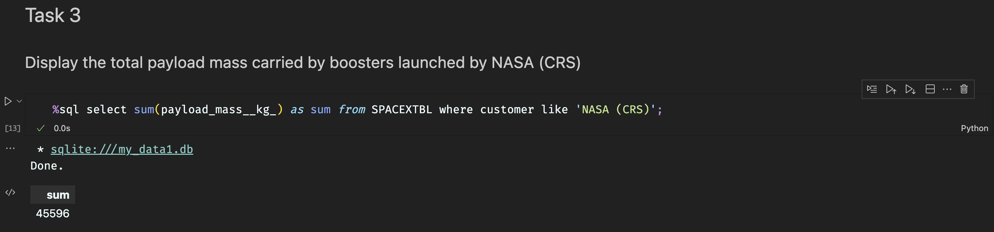
Total Payload Mass
Calculate the total payload carried by boosters from NASA
The SUM keyword is used to calculate the total of the LAUNCH column, and the SUM keyword (and the associated condition) filters the results to only boosters from NASA (CRS).

Slide 27
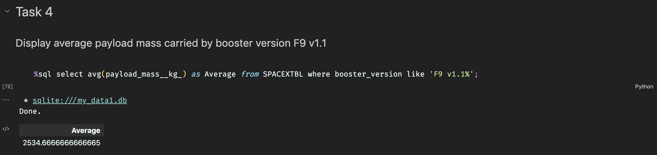
Average Payload Mass by F9 v1.1
Calculate the average payload mass carried by booster version F9 v1.1
The AVG keyword is used to calculate the average of the PAYLOAD_MASS__KG_ column, and the WHERE keyword (and the associated condition) filters the results to only the F9 v1.1 booster version.

Slide 28
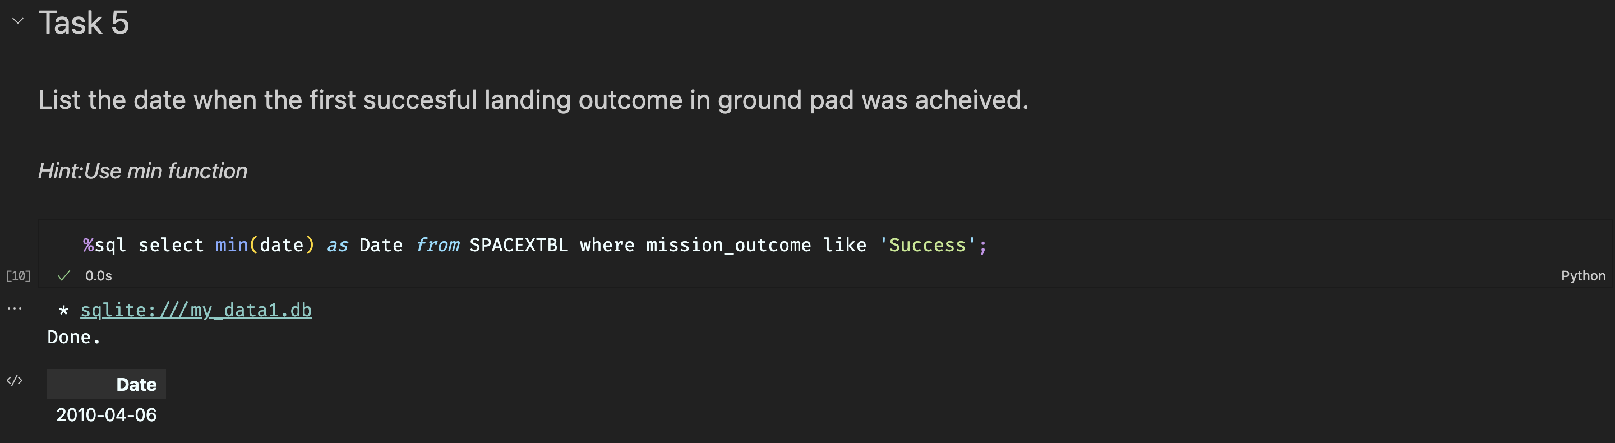
First Successful Ground Landing Date
Find the dates of the first successful landing outcome on ground pad
The MIN keyword is used to calculate the minimum of the DATE column, i.e. the first date, and the WHERE keyword (and the associated condition) filters the results to only the successful ground pad landings.

Slide 29
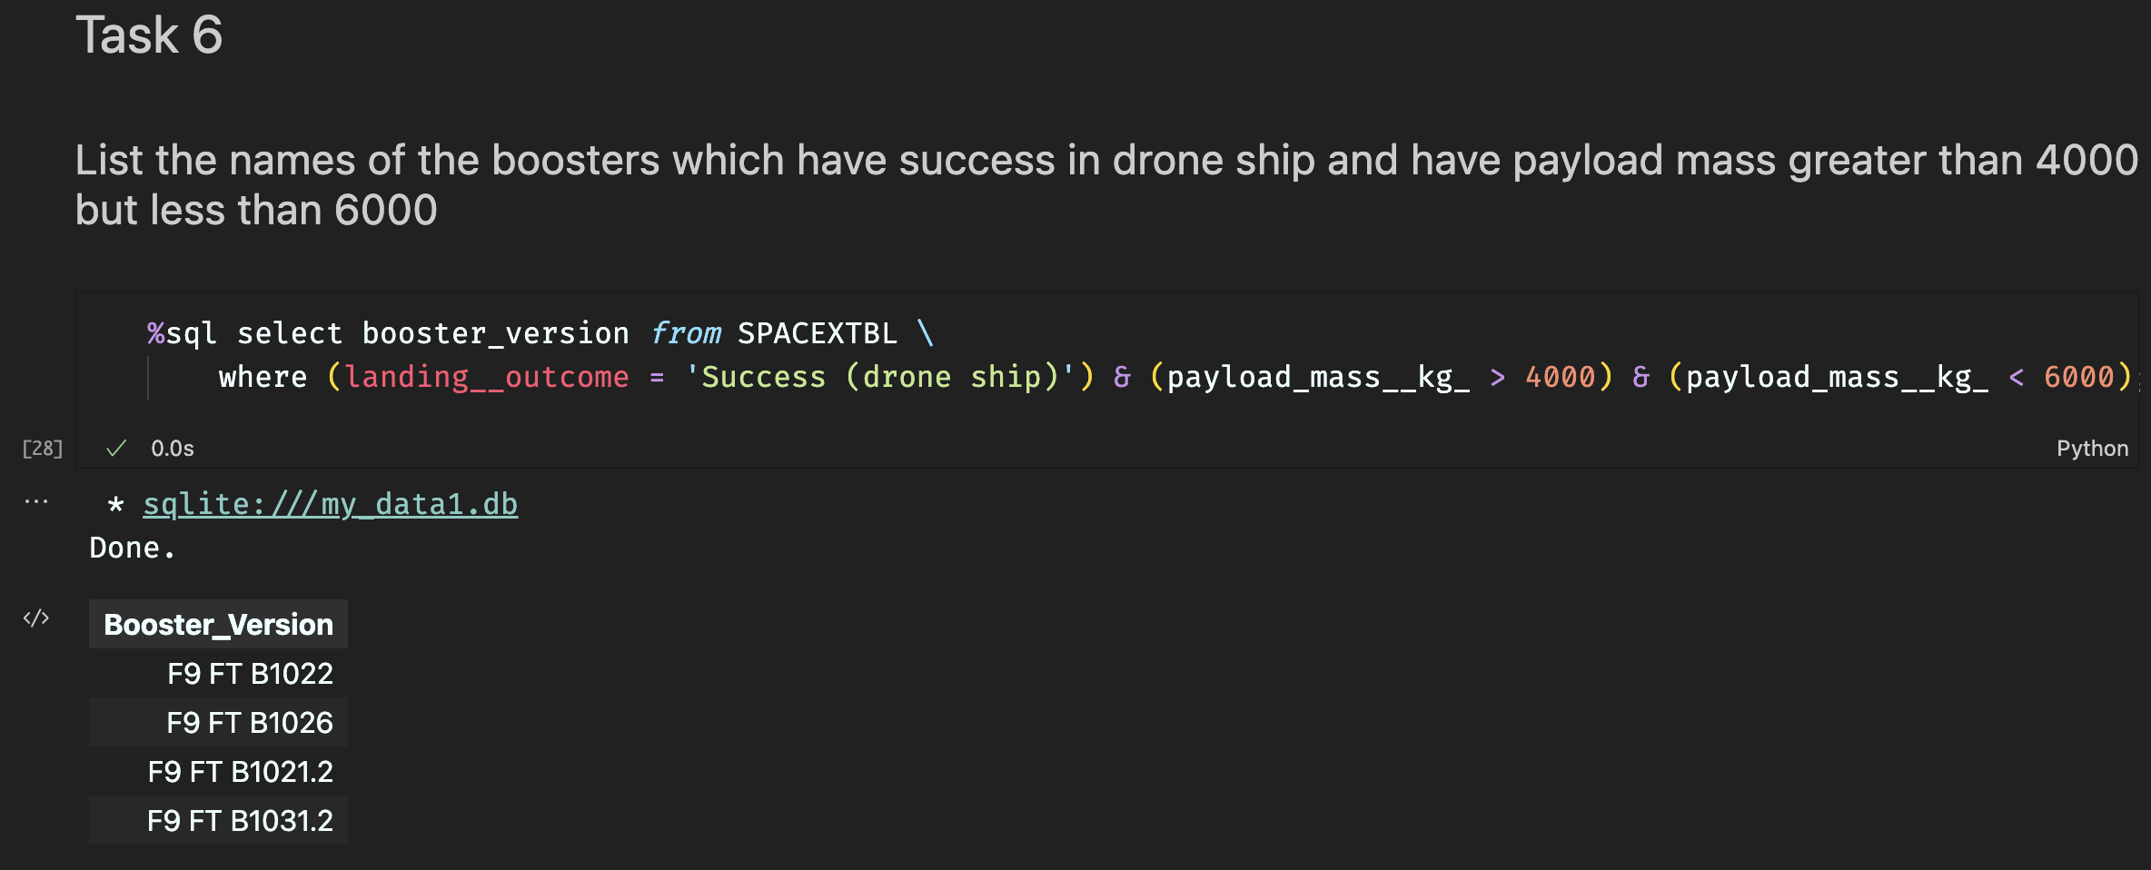
Successful Drone Ship Landing with Payload between 4000 and 6000
List the names of boosters which have successfully landed on drone ship and had payload mass greater than 4000 but less than 6000
The WHERE keyword is used to filter the results to include only those that satisfy both conditions in the brackets (as the AND keyword is also used). The BETWEEN keyword allows for 4000 < x < 6000 values to be selected.

Slide 30
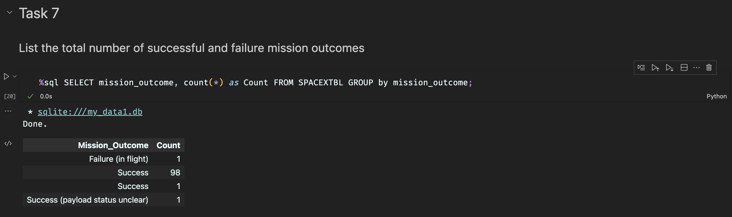
Total Number of Successful and Failure Mission Outcomes
Calculate the total number of successful and failure mission outcomes
The COUNT keyword is used to calculate the total number of mission outcomes, and the GROUPBY keyword is also used to group these results by the type of mission outcome.

Slide 31
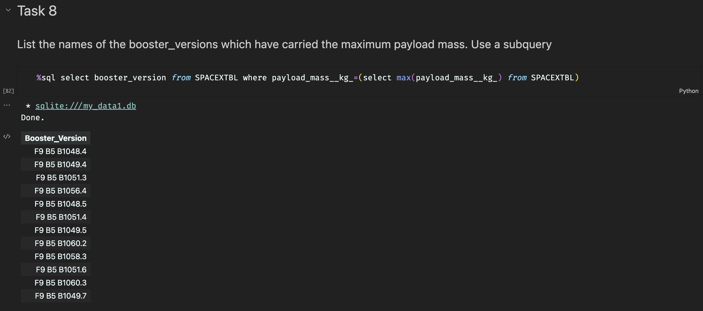
Boosters Carried Maximum Payload
List the names of the booster which have carried the maximum payload mass
A subquery is used here. The SELECT statement within the brackets finds the maximum payload, and this value is used in the WHERE condition. The DISTINCT keyword is then used to retrieve only distinct /unique booster versions.

Slide 32
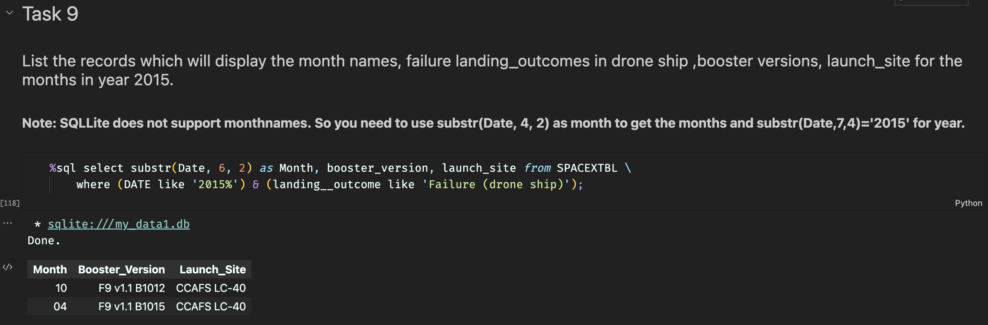
2015 Launch Records
List the failed landing_outcomes in drone ship, their booster versions, and launch site names for in year 2015
The WHERE keyword is used to filter the results for only failed landing outcomes, AND only for the year of 2015.

Slide 33
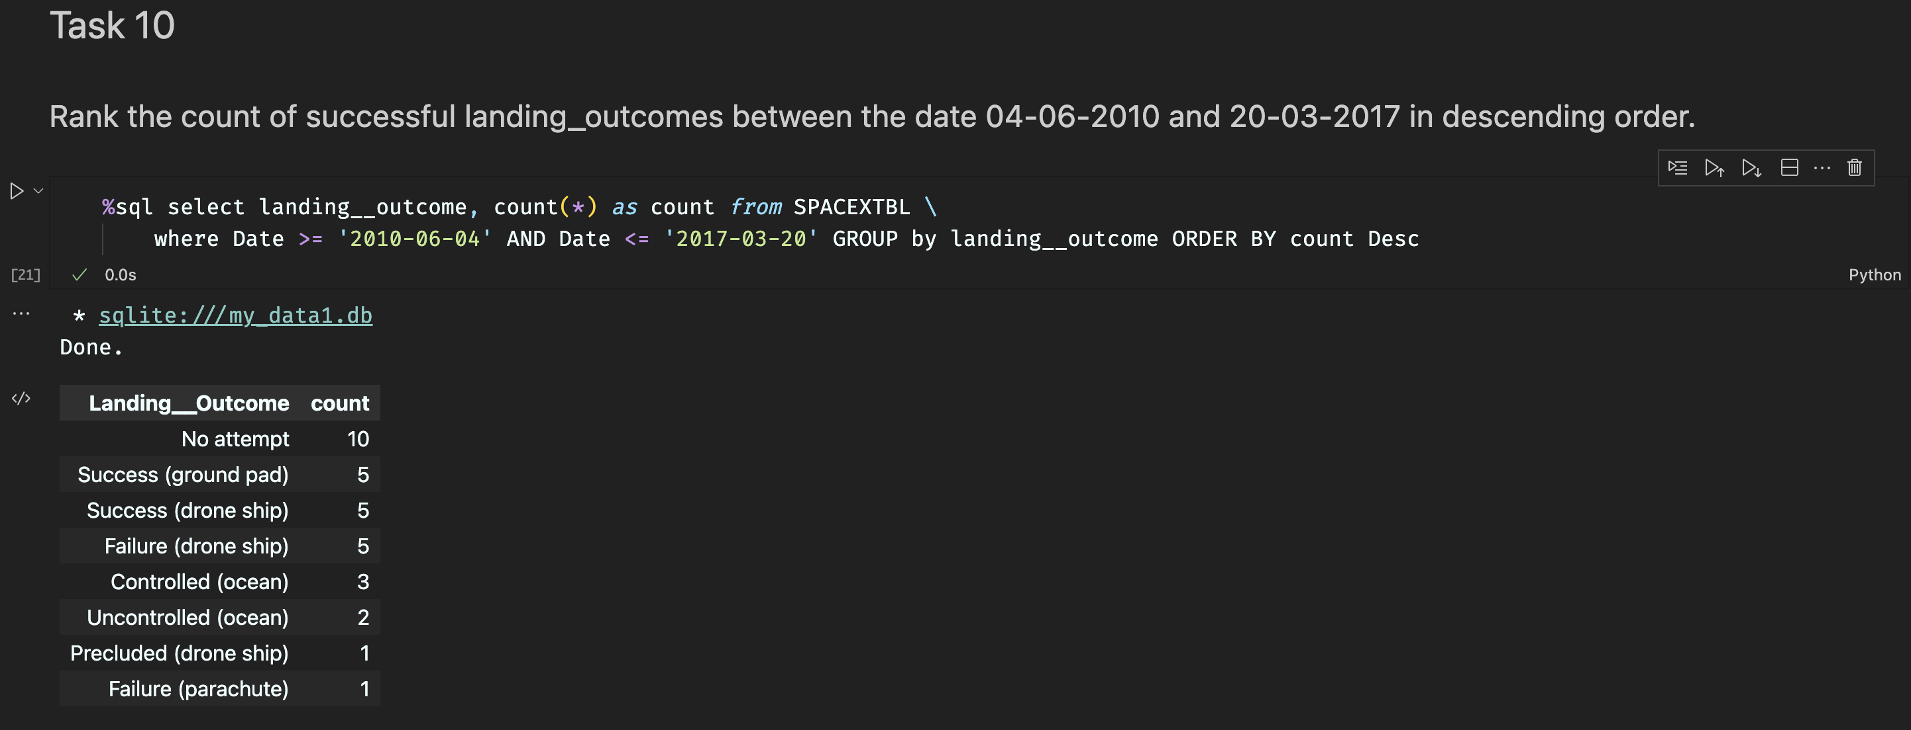
Rank Landing Outcomes Between 2010-06-04 and 2017-03-20
Rank the count of landing outcomes (such as Failure (drone ship) or Success (ground pad)) between the date 2010-06-04 and 2017-03-20, in descending order
The WHERE keyword is used with the BETWEEN keyword to filter the results to dates only within those specified. The results are then grouped and ordered, using the keywords GROUP BY and ORDER BY, respectively, where DESC is used to specify the descending order.

Slide 34

Section 3

Slide 35
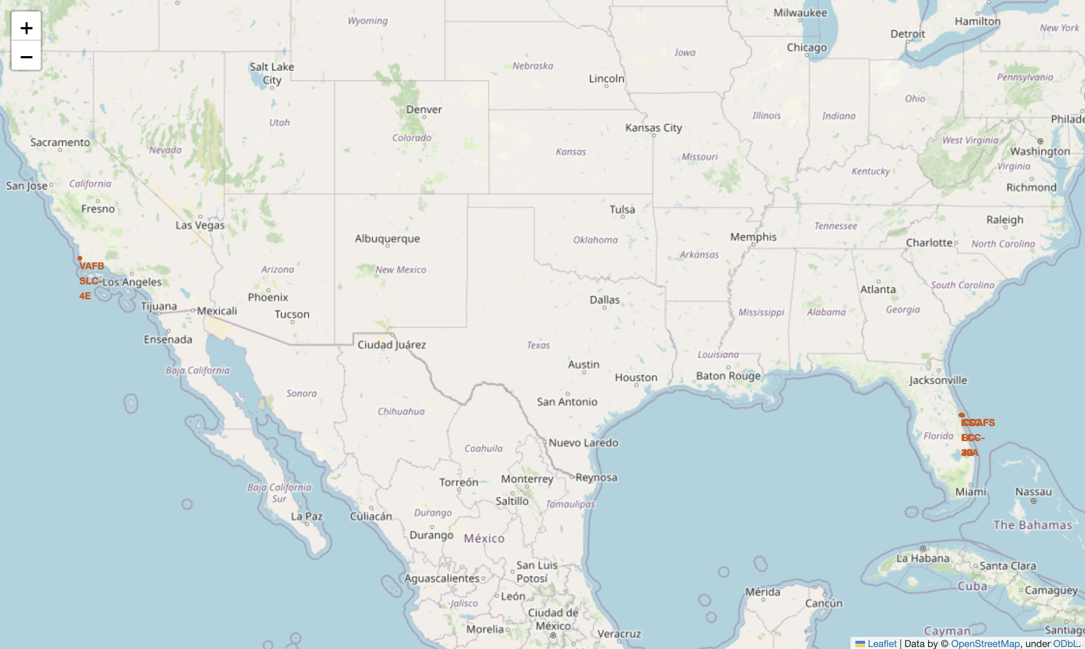
All Launch Sites on a Map
All SpaceX launch sites are on coasts of the United States of America, specifically Florida and California.

Slide 36
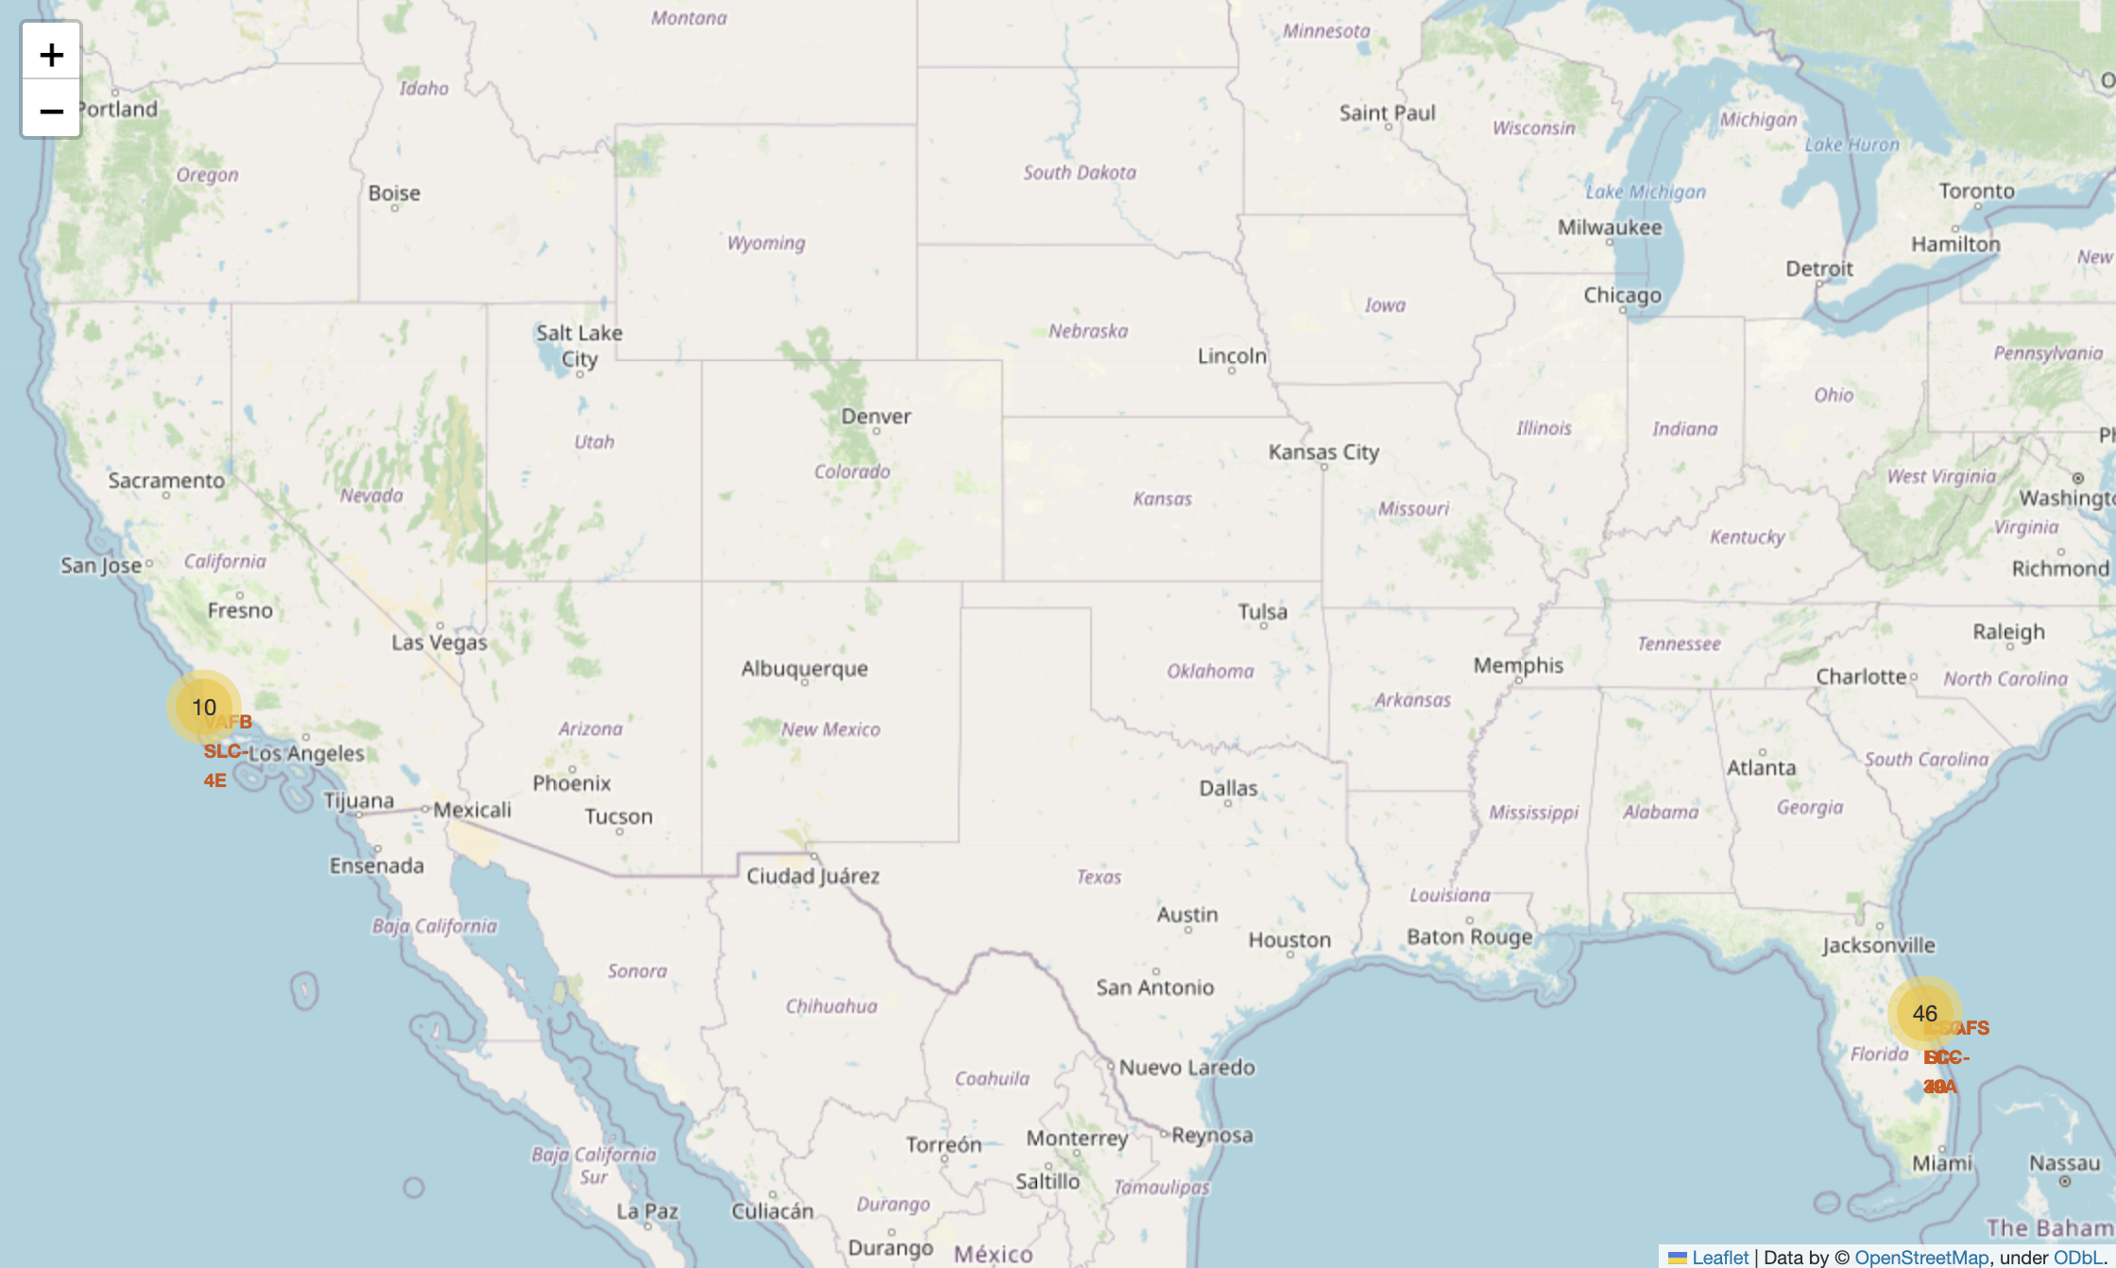
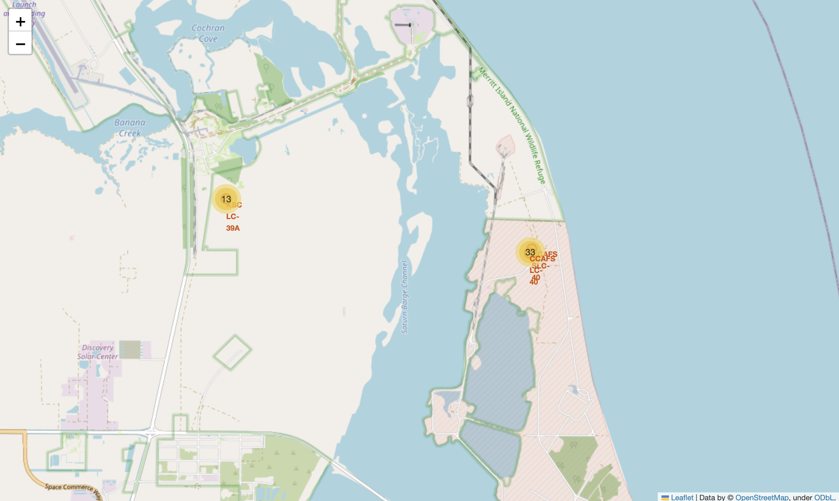
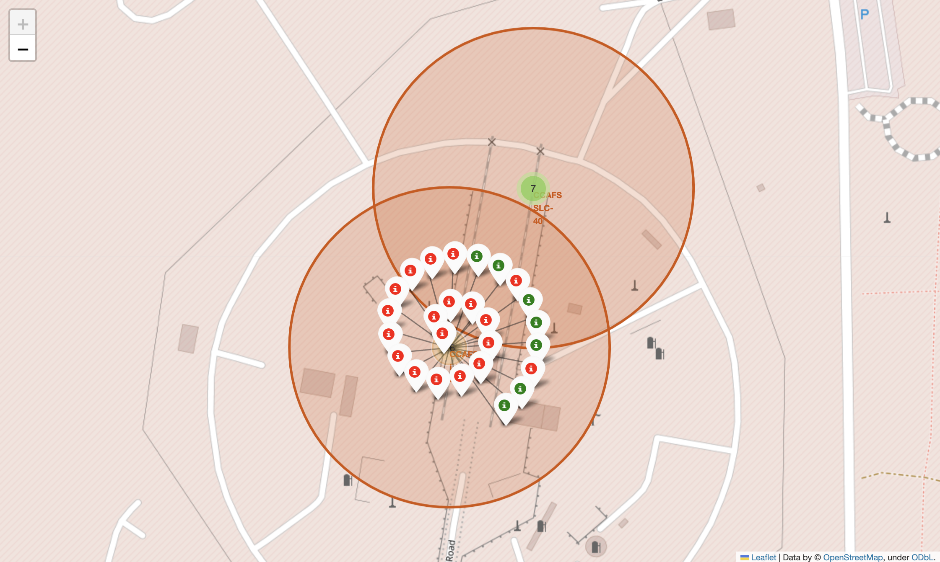
Success/Failed Launches for each Site
Launches have been grouped into clusters, and annotated with green icons for successful launches, and red icons for failed launches.

Slide 37
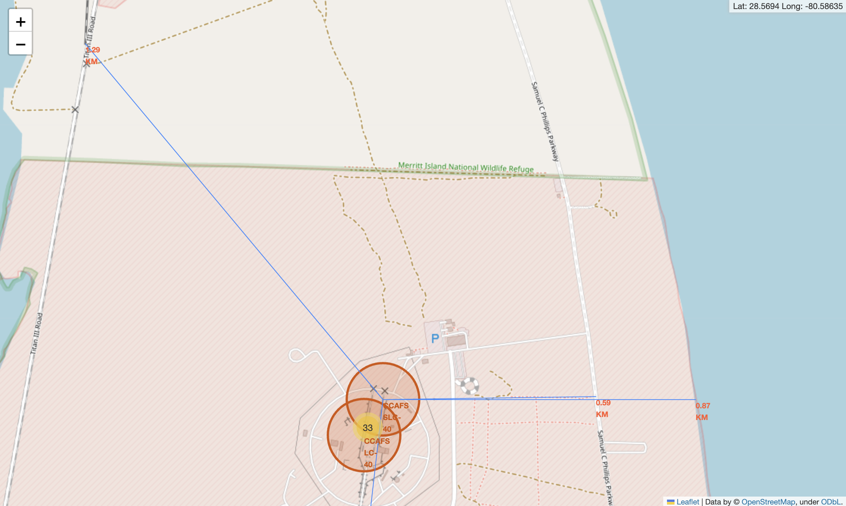
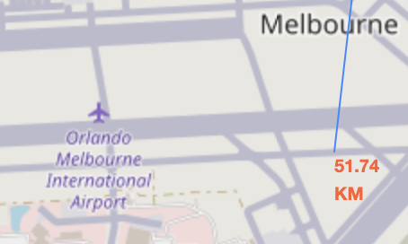
Proximity of Launch Sites to Other Points of Interest
From the folium map we know that for CCAFS SLC-40,
The nearest railway is 1.29 km away,
The nearest highway is 0.59 km away,
The nearest coastline is 0.87 km away,
The nearest airport is 51.74 km away

Slide 38

Section 4

Slide 39
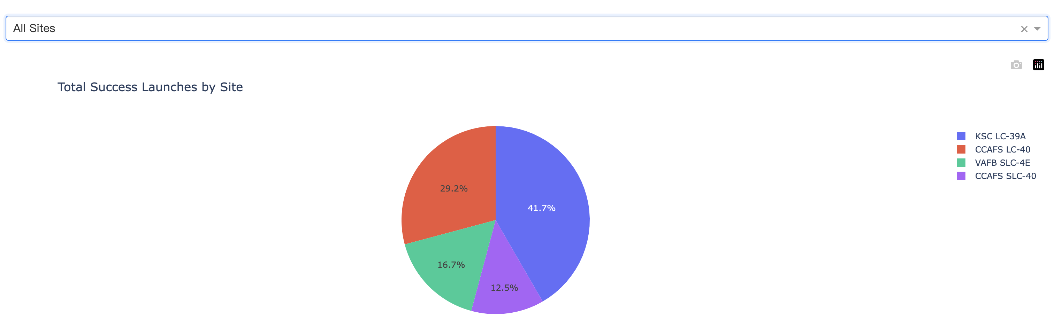
Launch Success Count for All Sites
The launch site KSC LC-39 A had the most successful launches, with 41.7% of the total successful launches.

Slide 40
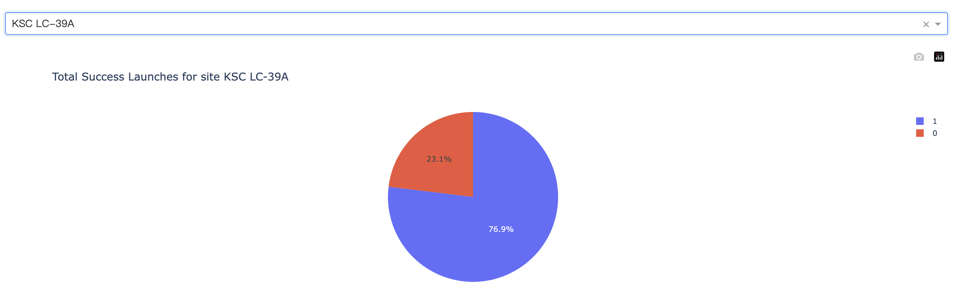
Pie Chart for the Launch Site with Highest Launch Success Ratio
The launch site KSC LC-39 A also had the highest rate of successful launches, with a 76.9% success rate.

Slide 41
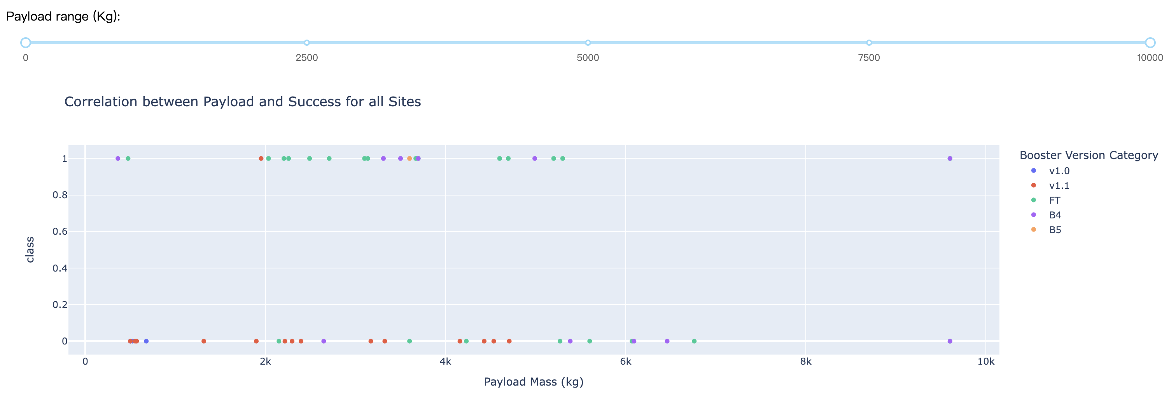
Launch Outcome VS. Payload Scatter Plot for All Sites
Payloads mass between 3000 and 4000 kg have the largest success rate
Booster Version is FT and payloads mass between 2000 and 3000 kg have the largest success rate

Slide 42

Section 5

Slide 43
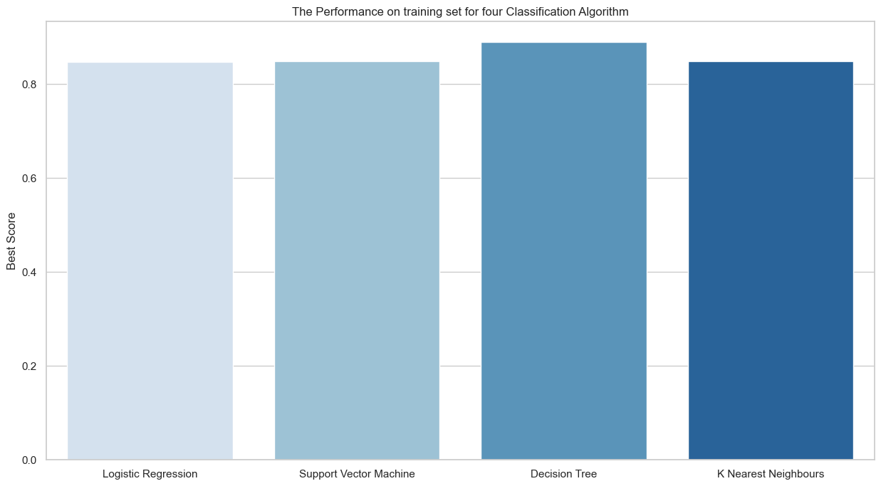
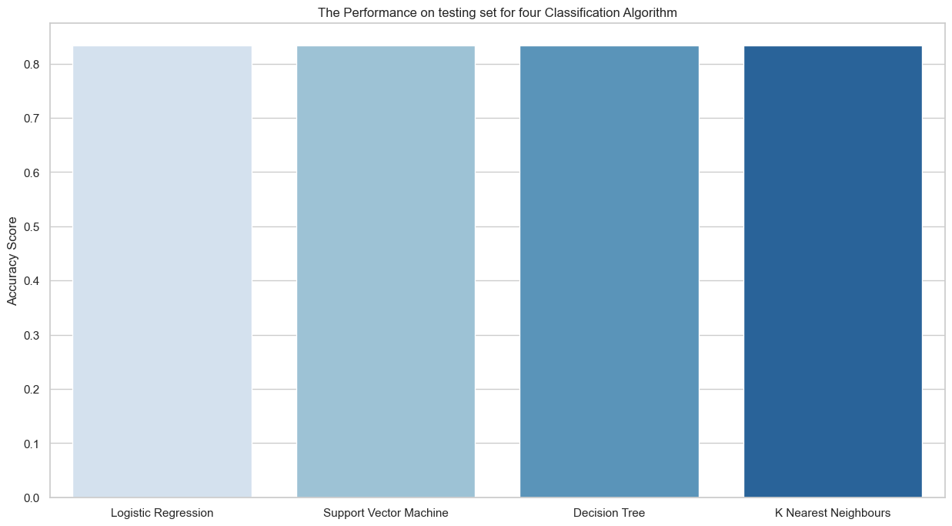
Classification Accuracy
From the bar chart we can observe that decision tree and KNN has the highest classification accuracy

Slide 44
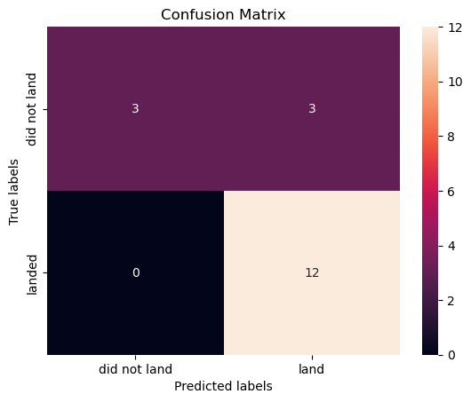
Confusion Matrix
The confusion matrix of the best performing model – Decision Tree is as right
3 results were classified incorrectly
15 results were classified correctly
For labels “did not land”, the correctly classified rate is 50%
For labels “land”, the correctly classified rate is 100%

Slide 45
Conclusions
Flights with flight numbers less than 25 were mostly launched at CCAFS SLC 40
CCAFS SLC 40 has the lowest successful launch rate
The successful launch rate increase as flight number increase
Flights with payload mass higher than 7500 has a higher successful launch rate
Orbit types VLEO and SSO have the highest and most impressive success rate higher than 80%
For LEO, ISS, and PO flights with higher payload mass have a higher success rate
Before 2013, all launched failed
After 2013, the success rate increased, with small dips in 2018 and 2020
The best-performing classification model for this dataset is the Decision Tree model

Slide 46
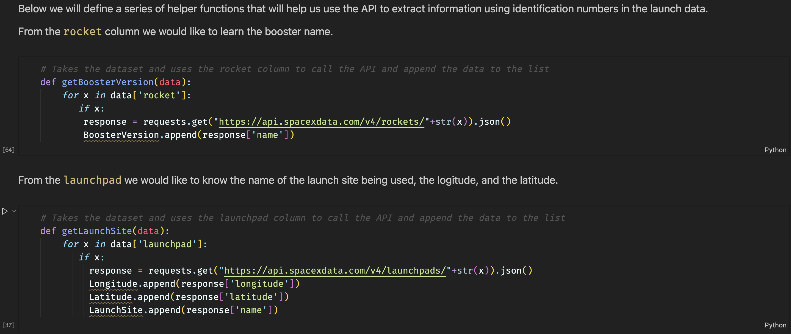
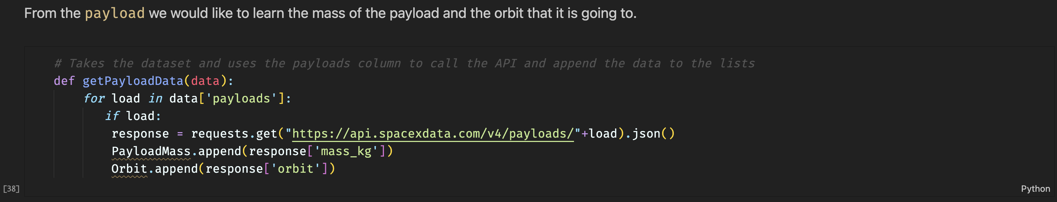
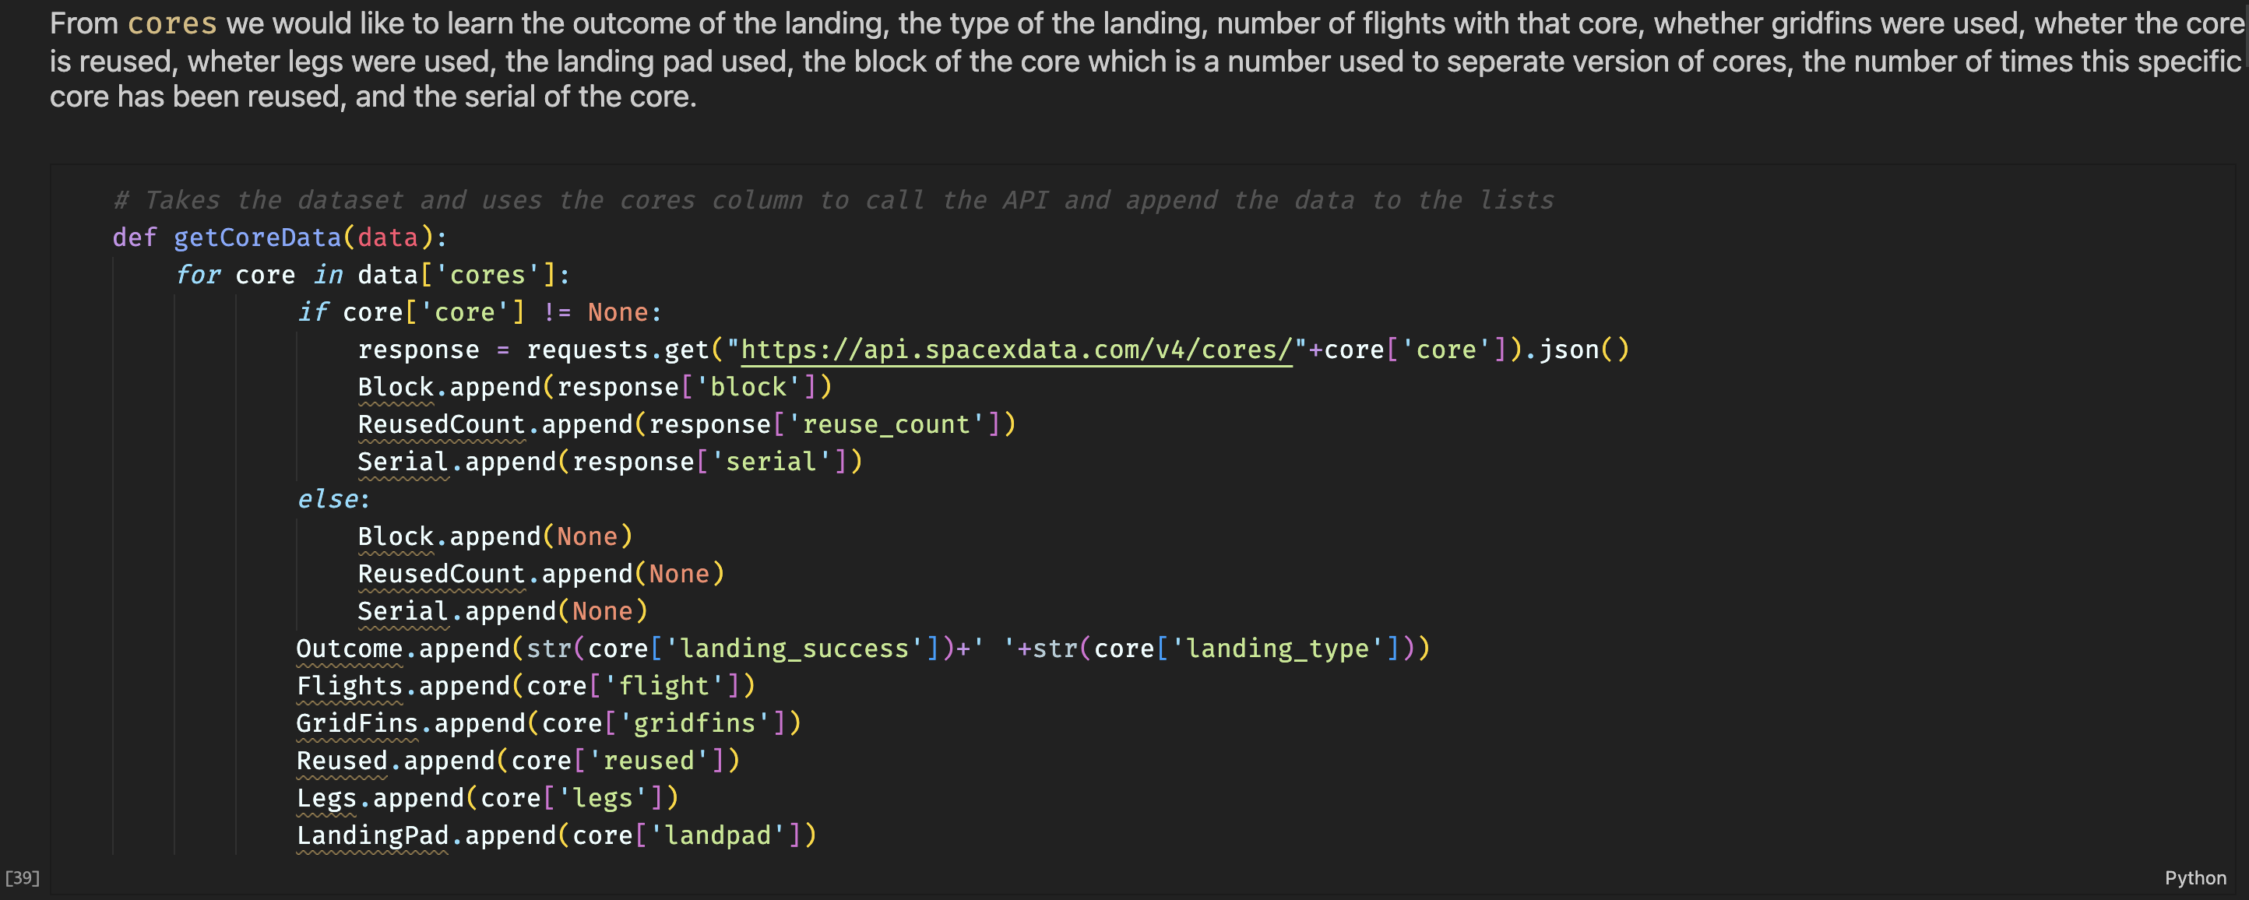
Appendix
In Data Collection – SpaceX API
define a series of helper functions that will help us use the API to extract information using identification numbers in the launch data.

Slide 47
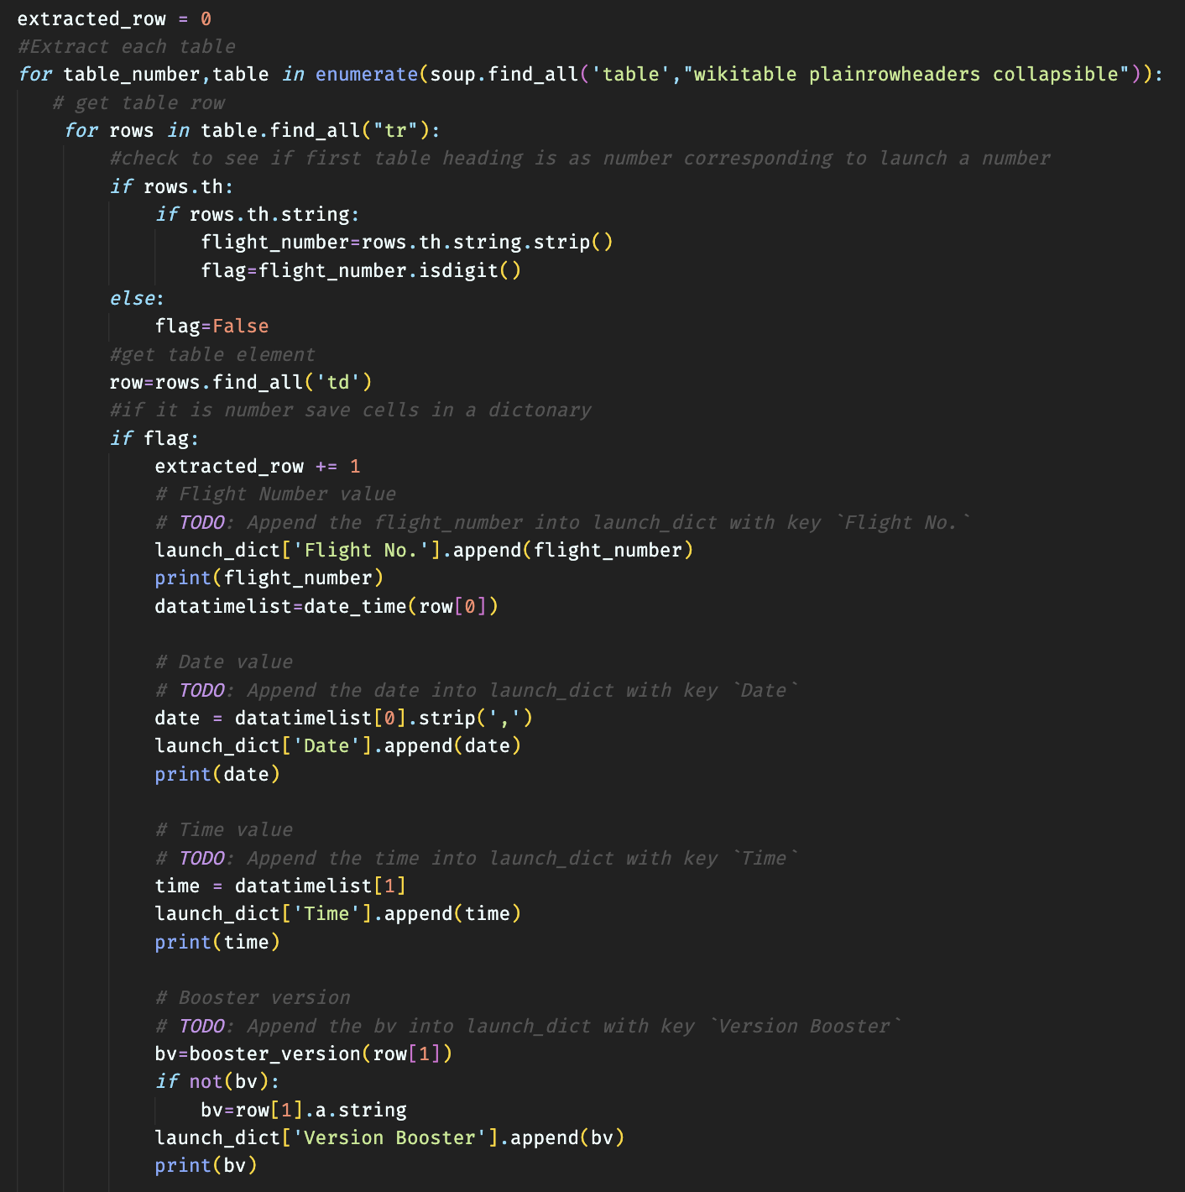
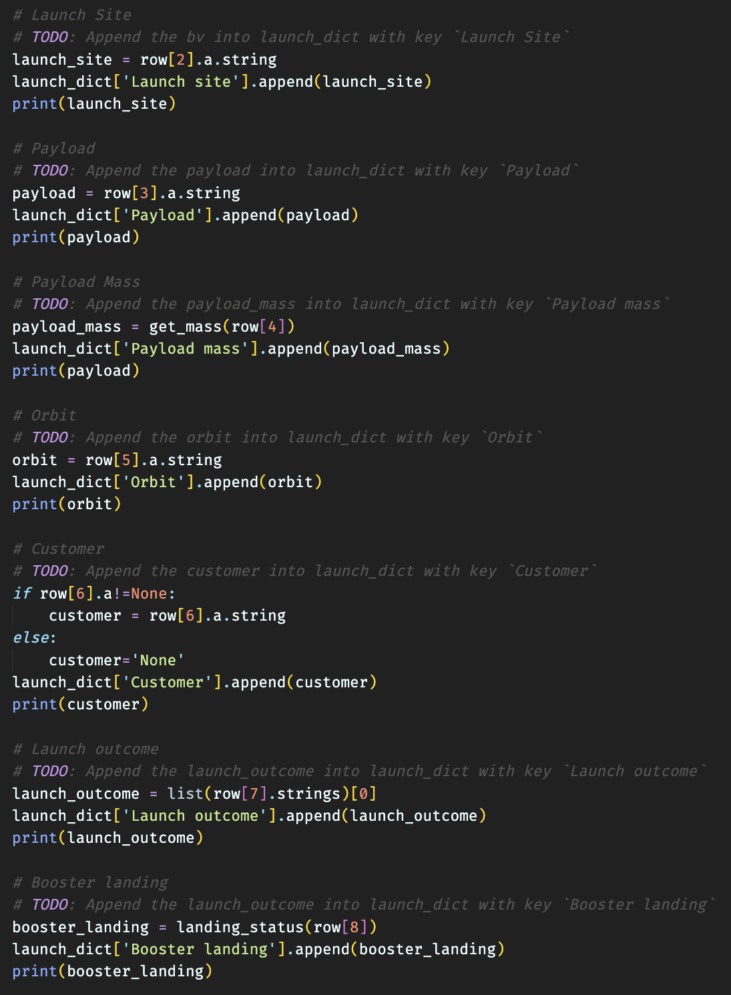
Appendix
In Data Collection – Scraping
Define code to clean the data from the wiki

Slide 48


